Slide 1

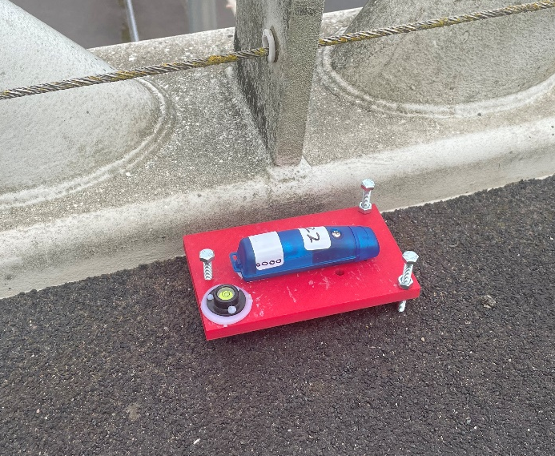
Suspension bridge (UK)
Testing Setup
20 sensors = 14 ref. + 6 rovers
4 setups @ 30 min
38 locations
Wireless GCDC sensors with algorithm for synchronisation
Motorway suspension bridge
Steel box girder deck
Three span 305m+988m+305m

Slide 2



Vertical modes
Frequency (c.o.v.)
Damping (c.o.v.)
VS2
VS1
VA1
0.226 Hz (0.31%)
1.3% (33%)
0.145 Hz (0.43%)
1.6% (26%)
0.184 Hz (0.49%)
2.8% (23%)
$$z$$
$$y$$
$$x$$

Slide 3
Vertical modes (side spans)
Frequency (c.o.v.)
Damping (c.o.v.)
SV1
SV2
0.286 Hz (0.61%)
3% (19%)
0.305 Hz (0.23%)
1.1% (26%)
$$z$$
$$y$$
$$x$$

Slide 4
Vertical modes
Frequency (c.o.v.)
Damping (c.o.v.)
T1
VS3
VA2
0.352 Hz (0.17%)
0.7% (32%)
0.42 Hz (0.22%)
0.68% (39%)
0.317 Hz (0.27%)
1.2% (13%)
$$z$$
$$y$$
$$x$$

Slide 5
Lateral modes
Frequency (c.o.v.)
Damping (c.o.v.)
L3
L1
L2
0.413 Hz (0.44%)
1.3% (39%)
0.0836 Hz (1.4%)
8% (27%)
0.236 Hz (0.51%)
3.6% (12%)
$$z$$
$$y$$
$$x$$

